Slide 1
Computer Vision
Part 1: Visualization and Understanding
ADF – Start 08:30

Slide 2

Agenda
Part 1: Visualizing Weights
Feature Representation, Image Patch Activation
Part 2: Visualization via Optimization
Input that maximizes the target
Deep Dream
Computer Vision

Slide 3
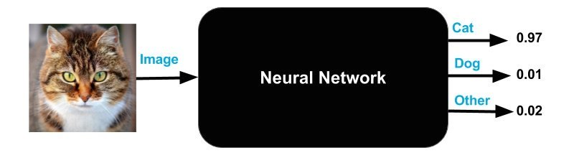
It’s Magic?
Neural Net were often thought as a black box magic
It works, but hard to explain how
Computer Vision

Slide 4
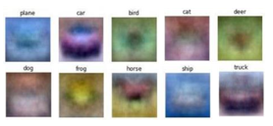
Black Box Magic
We know that linear classifier is like creating image template for each class
And each neuron in Multi Layered Perceptron is a linear classifier
But the feature cannot be visualized
Computer Vision

Slide 5
It’s Magic?
Even after AlexNet, it’s still regarded as magic
Only after 2013 that research to explain why ConvNet work were widely conducted
Computer Vision

Slide 6
It’s NOT Magic, apparently
Visualization and Understanding
Not about improving the Model Performance per se
Or to design new algorithm
But rather to understand how and why it works
And give evidence that its work is not a Magic
And it’s not a random either
Also, it leads to further fun and interesting Computer Vision implementations
Computer Vision

Slide 7
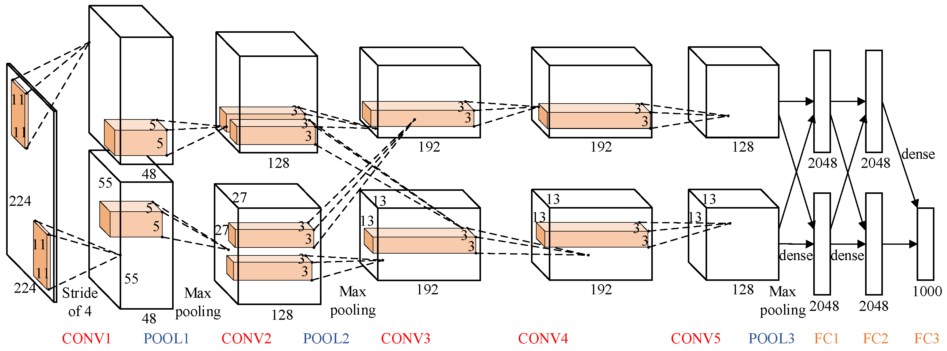
One-Stream AlexNet
1
6
7
2
3
4
5
conv1 feature
pool5 feature
fc7 feature
Computer Vision
Notes:
Simplest way to understand, look at the raw activation of the convnet

Slide 8
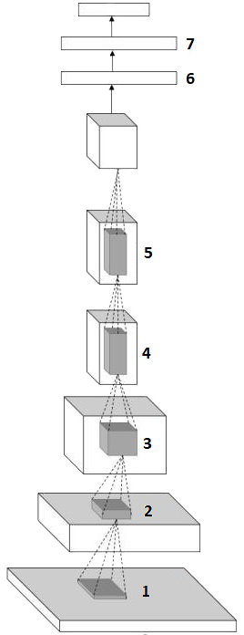
Network Visualization
What’s easy:
Visualizing first layer’s weights (filters)
Visualizing output representation
What’s not easy:
Visualizing middle filters
Determine what part of input that support the decision
Computer Vision

Slide 9
Visualizing Weights
Computer Vision

Slide 10
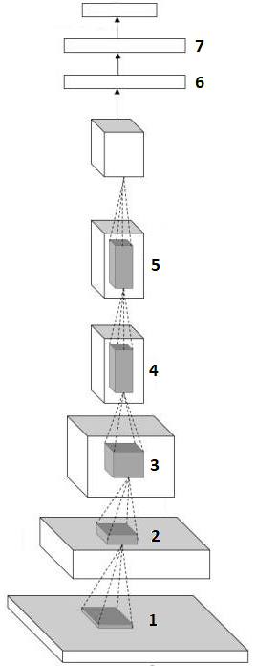
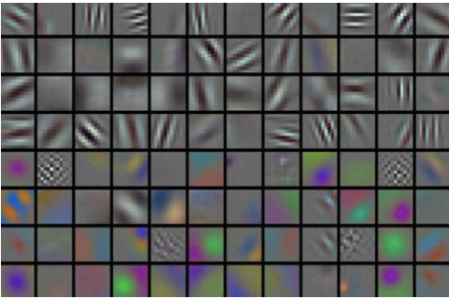
Visualize the filters/kernels (raw weight)
conv1
Rotate Gabor-like feature,
only interpretable on the first layer
Computer Vision
Notes:
- Not just looking at the activation, but looking at the weights
- Only interpretable on the first layer

Slide 11
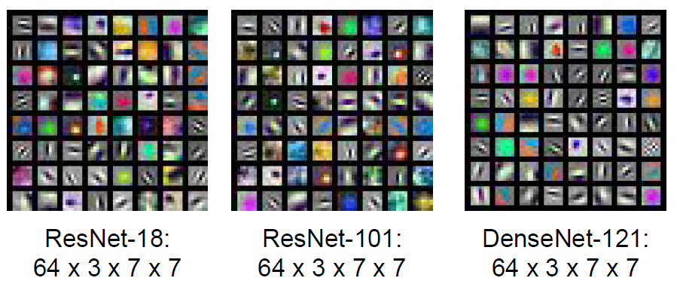
Visualize the filters/kernels (raw weight)
conv1
Similar for any ConvNet model
Computer Vision
Notes:
- Not just looking at the activation, but looking at the weights
- Only interpretable on the first layer

Slide 12
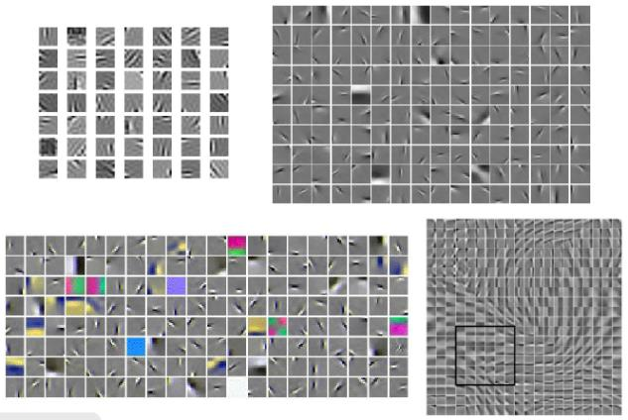
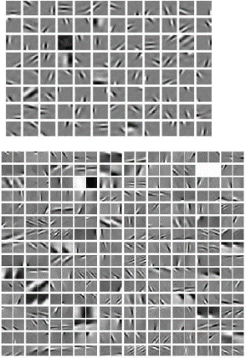
The Gabor-like Filters
Computer Vision
Notes:
Almost all learning feature methods resulting Gabor-like feature

Slide 13
Conclusion 1
It DID create low level feature extraction
Support the original Neural Net Hypothesis
What about the output?
Computer Vision

Slide 14
Visualizing Feature Representation
Computer Vision

Slide 15
Visualizing Representation
fc7 layer
4096-dimensional “code” or “feature vector” for an image
(layer immediately before the classifier)
Run the network on many images, collect the feature vectors
Computer Vision
Notes:
Get the fc7 image → codes of the data

Slide 16
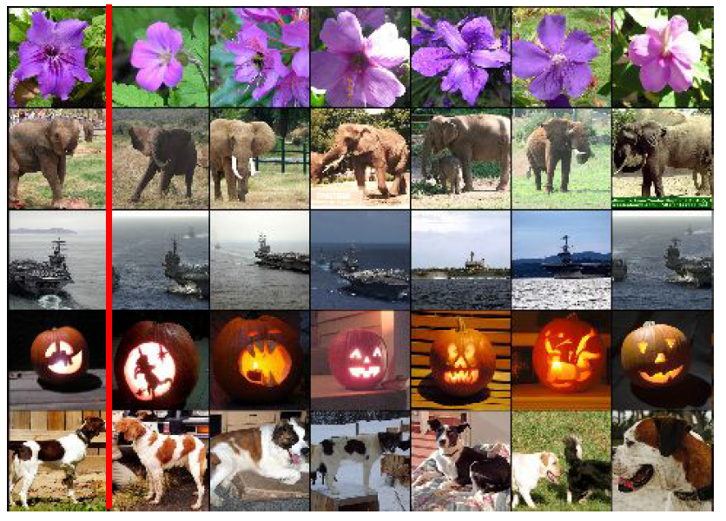
Nearest Neighbor using Image Representation
fc7 layer
Computer Vision
Notes:
Get the fc7 image → codes of the data

Slide 17
t-SNE Visualization
Computer Vision

Slide 18
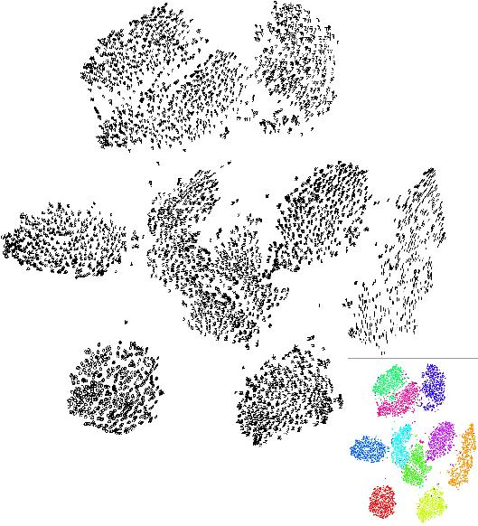
t-SNE Visualization
Embed high-dimensional points so that locally, pairwise distances are conserved
i.e. similar things end up in similar places. dissimilar things end up wherever
Example embedding of MNIST digits, (0-9) in 2D
[van der Maaten & Hinton]
Computer Vision
Notes:
One way to visualize: t-distributed stochastic neighbors embedding
Find embedding of 2D from high dimension collection, that points out the nearby space
28x28 mnist, embed to 2D, clustered in 0-9

Slide 19
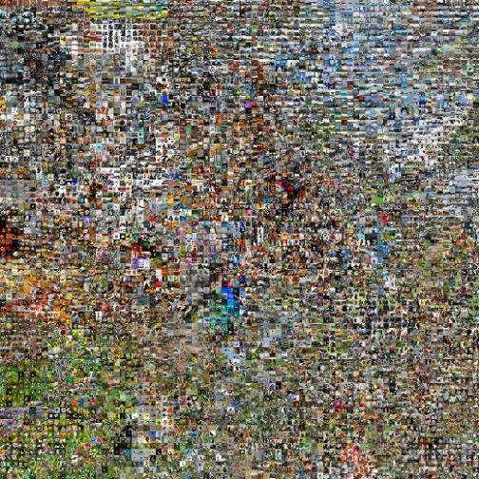
t-SNE Visualization
two images are placed nearby if their CNN codes are close
http://cs.stanford.edu/people/karpathy/cnnembed/
Computer Vision
Notes:
Clustered by the neural score

Slide 20
Conclusion 2
ConvNet DID work as a Feature Extraction
or Dimensionality Reduction
Computer Vision

Slide 21
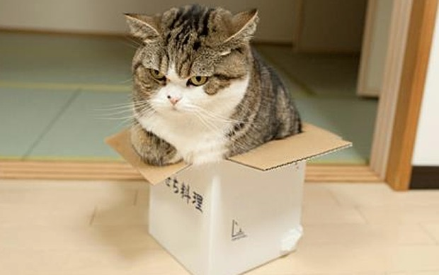
Next Question
If we feed an image with a "Cat" in it into a ConvNet, and the ConvNet recognize the cat (output a cat prediction),
did the decision come from the cat part of the image or some other part of the image?
Computer Vision

Slide 22
Occlusion Experiments
Computer Vision

Slide 23
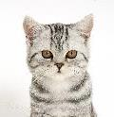
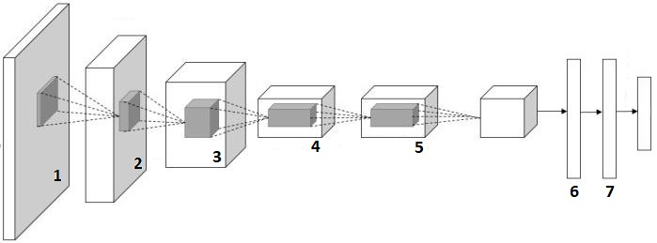
Occlusion Experiments
Input an image to ConvNet, and record the output probability
Partially damage (occlude) the image, repeat
Probability of cat
[Zeiler & Fergus 2013]
Computer Vision

Slide 24
Occlusion Experiments
Patch of zeros, Slide through the entire image
Map each output score relevant to the target in form of heat-map
[Zeiler & Fergus 2013]
Computer Vision

Slide 25
Occlusion Experiments
Hypothesis: If a part of image is not important to the decision, the score won’t decrease, And vice versa,
[Zeiler & Fergus 2013]
Computer Vision

Slide 26
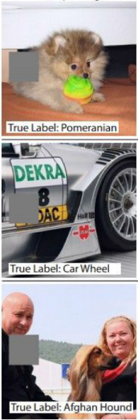
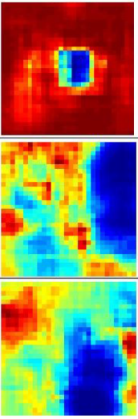
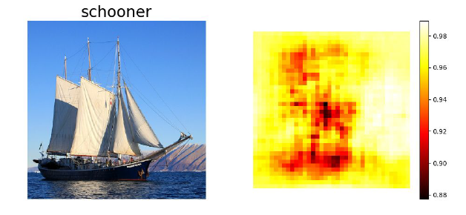
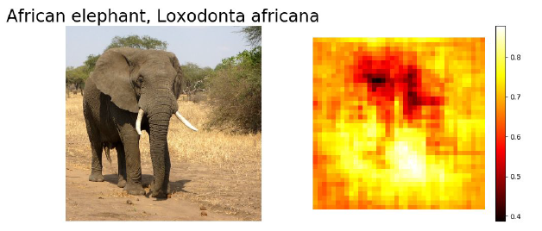
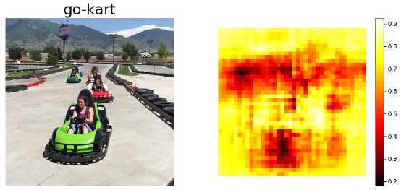
Occlusion Experiments
Computer Vision

Slide 27
Conclusion 3
The decision score DOES come from the object present in the image
ConvNet did not produce a random decision
Computer Vision

Slide 28
Next Question
We know what activation map is
Activation Map
Computer Vision
Notes:
We’ll have an entire filter bank

Slide 29
Next Question
We know what activation map is
If a filter produce high activation from an input image,
Computer Vision
Notes:
We’ll have an entire filter bank

Slide 30
Next Question
We know what activation map is
If a filter produce high activation from an input image,
Which part of the image induce that high activation?
Will it always produce the same high activation from any similar image?
Computer Vision

Slide 31
Visualizing Image Patch Activation
Computer Vision

Slide 32
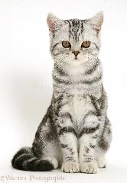
Visualizing Image Patch Activation
Choose an Activation map
pool5
conv1
... ...
pool5, filter 1
Feed Images
find the
max activation
Computer Vision
Notes:
- Pick on a arbitrary neuron, say in pool5 layer, pipe a lot of images through, and see what excites the neurons the most
- example: row → neuron, image→ something that excites neuron

Slide 33
Visualizing Image Patch Activation
pool5
... ...
pool5, filter 1
From the selected activation
Backtrack location to input
Computer Vision
Notes:
- Pick on a arbitrary neuron, say in pool5 layer, pipe a lot of images through, and see what excites the neurons the most
- example: row → neuron, image→ something that excites neuron

Slide 34
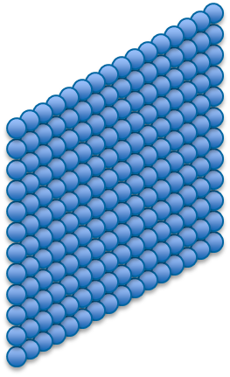
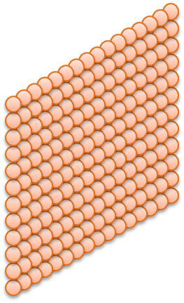
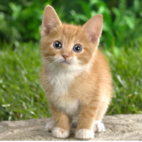
Visualizing Image Patch Activation
Max Value
Conv1
Conv2
Computer Vision

Slide 35
Visualizing Image Patch Activation
pool5
... ...
pool5, filter 1
Computer Vision
Notes:
- Pick on a arbitrary neuron, say in pool5 layer, pipe a lot of images through, and see what excites the neurons the most
- example: row → neuron, image→ something that excites neuron

Slide 36
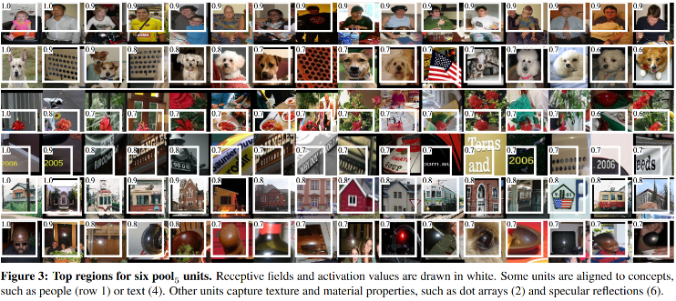
Visualizing Image Patch Activation
Computer Vision
Notes:
- Pick on a arbitrary neuron, say in pool5 layer, pipe a lot of images through, and see what excites the neurons the most
- example: row → neuron, image→ something that excites neuron

Slide 37
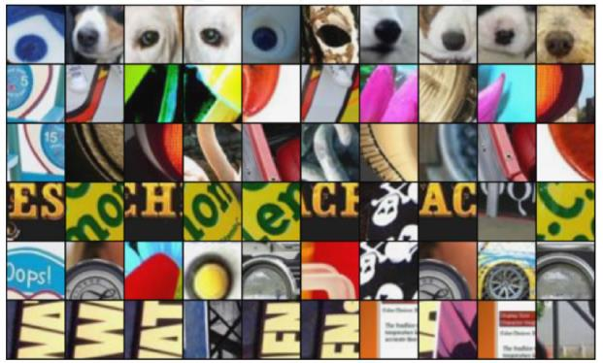
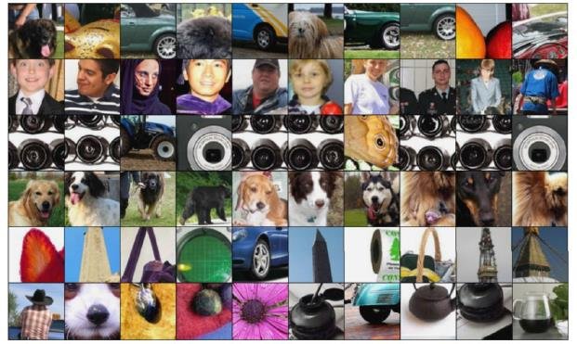
Visualizing Image Patch Activation
From Deeper Layer
From Lower Layer
The deeper the layer of a filter
The wider the receptive field (what that neuron sees)
Computer Vision

Slide 38
Conclusion 4
A filter is activated by the same type of input patch
ConvNet DOES forms low level feature extraction in the lower layer, and more complex feature extraction at the deeper layer
Computer Vision

Slide 39
Next Question
Occlusion experiment was carried out by looping
Backtracking activation to input image manually is rather primitive
Is there any simpler and faster way to do it?
Computer Vision

Slide 40
Visualizing Gradients
Computer Vision

Slide 41
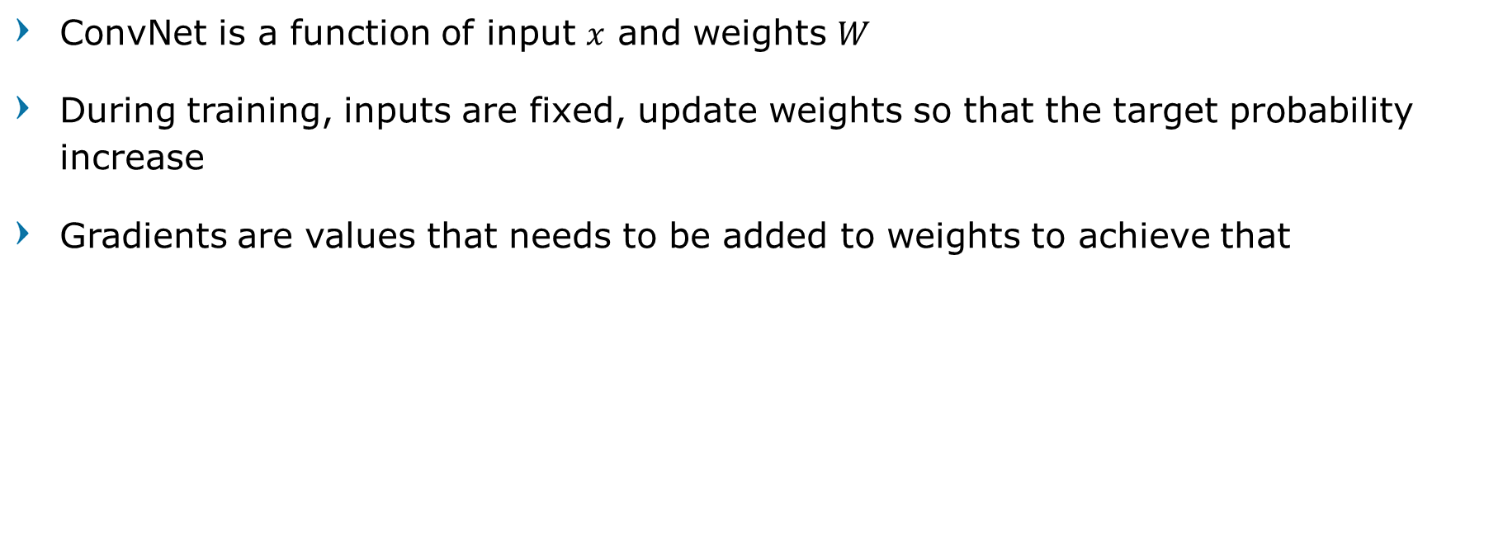
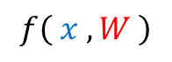
Remember Gradients
ConvNet is a function of input $x$ and weights $W$
During training, inputs are fixed, update weights so that the target probability increase
Gradients are values that needs to be added to weights to achieve that
Cat probability
$$f\left( x , W \right)$$
Computer Vision

Slide 42
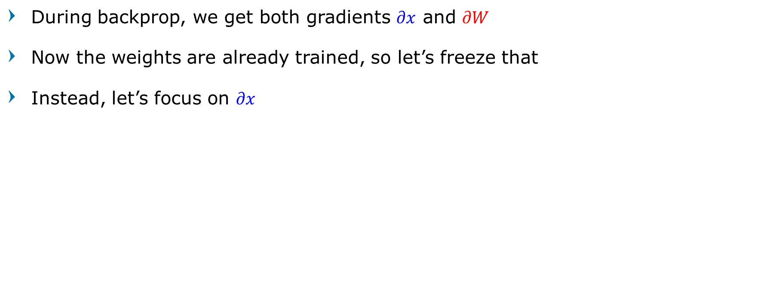
Let’s Flip Our Perspective
During backprop, we get both gradients $∂x$ and $∂W$
Now the weights are already trained, so let’s freeze that
Instead, let’s focus on $∂x$
Cat probability
$$f\left( x , W \right)$$
Computer Vision

Slide 43
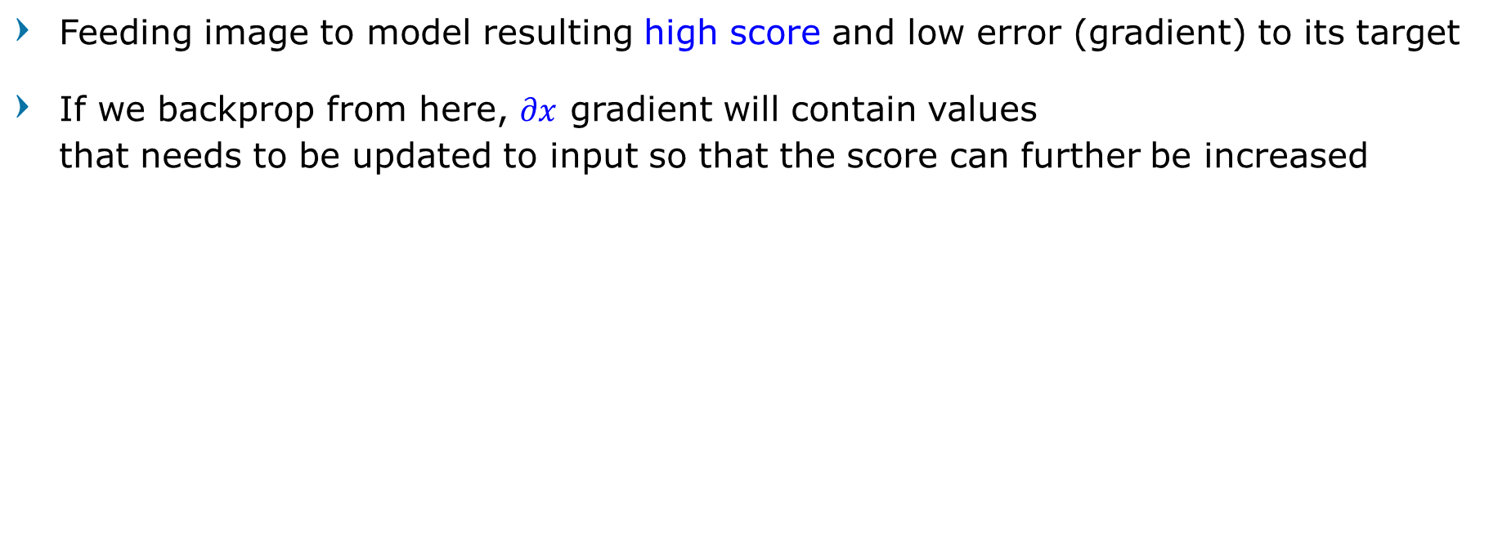
Testing an Image
Feeding image to model resulting high score and low error (gradient) to its target
If we backprop from here, $∂x$ gradient will contain values that needs to be updated to input so that the score can further be increased
Cat probability
$$f\left( x , W \right)$$
Computer Vision

Slide 44
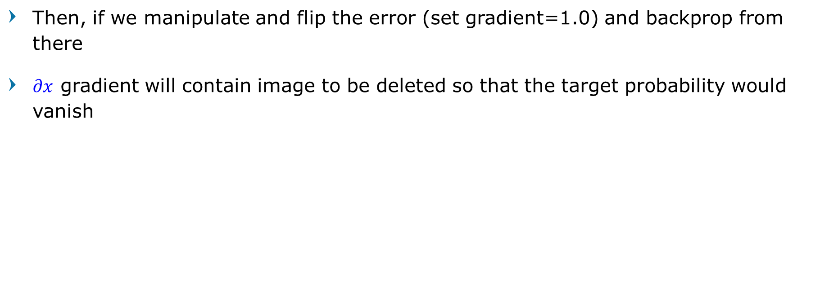
Let’s Flip Our Perspective
Then, if we manipulate and flip the error (set gradient=1.0) and backprop from there
$∂x$ gradient will contain image to be deleted so that the target probability would vanish
Cat probability
$$f\left( x , W \right)$$
Computer Vision

Slide 45
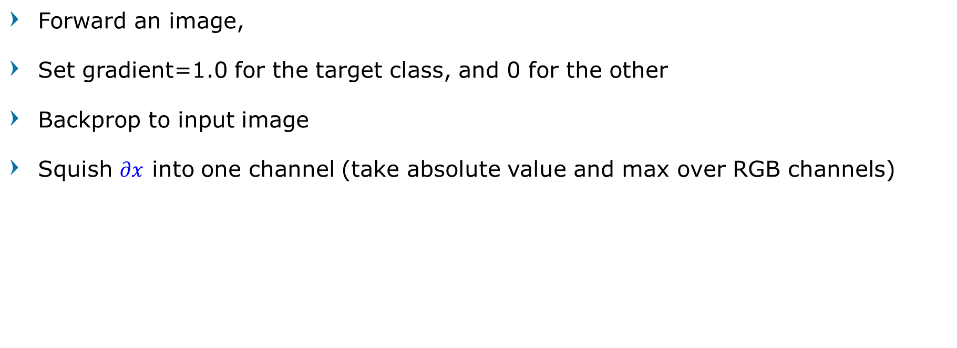
Saliency Maps
Forward an image,
Set gradient=1.0 for the target class, and 0 for the other
Backprop to input image
Squish $∂x$ into one channel (take absolute value and max over RGB channels)
Cat probability
$$f\left( x , W \right)$$
Computer Vision

Slide 46
Saliency Maps
Feed Images
Class score
0
1
…
…
0
Choose class set gradient=0 except the chosen class
Backprop Gradients
Computer Vision
Notes:
- Pick on a arbitrary neuron, say in pool5 layer, pipe a lot of images through, and see what excites the neurons the most
- example: row → neuron, image→ something that excites neuron

Slide 47
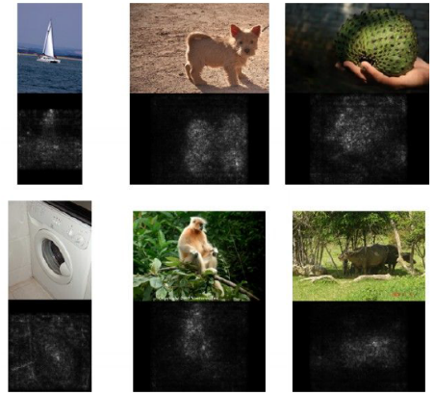
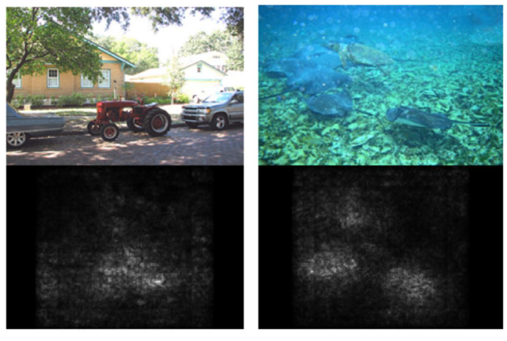
Saliency Maps
[Deep Inside Convolutional Networks: Visualising Image Classification Models and Saliency Maps, Karen Simonyan, Andrea Vedaldi, Andrew Zisserman, 2014]
Computer Vision

Slide 48
Conclusion 5
Using gradients and Backpropagation, we can immediately infer the location which maximize the target probability
Can we also do it to visualize what activate a filter in any layer?
Computer Vision

Slide 49
Intermediate Features via Backprop
Computer Vision

Slide 50

Visualizing Intermediate Features
Pick a layer and a filter (the activation map)
Forward pass until that layer
Set gradient=1.0 for the selected activation map, and 0 for all other
pool5
$$f\left( x , W \right)$$
Computer Vision

Slide 51
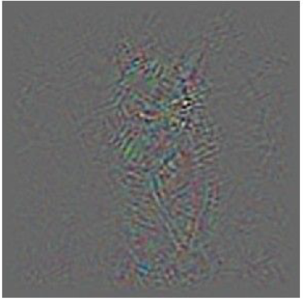
Visualizing Intermediate Features
Backprop to input image
pool5
$$f\left( x , W \right)$$
Computer Vision

Slide 52
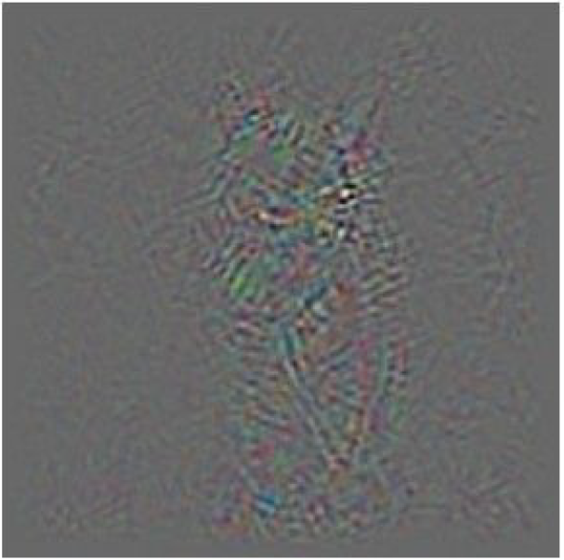
Visualizing Intermediate Features
Initially called DeConv approach
But The visualization is not very nice
Can we smoothen it out?
Computer Vision

Slide 53
Guided Backpropagation
Computer Vision

Slide 54
Guided Backprop
Similar to activation map, values of gradient indicates whether the neuron is positively activated or instead negatively activated
Since we only care about input that excites the filter, then we don’t have to backprop the negative gradient
Kind of like ReLU for Gradient
Computer Vision

Slide 55
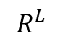
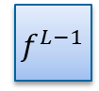
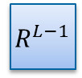
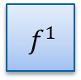

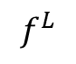
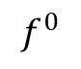
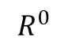
Normal Backprop
Forward pass
$$f^{1}$$
...
$$f^{L−1}$$
1 | 0
3 | 2
$$f^{0}$$
$$f^{L}$$
Input image
Feature map
$$R^{1}$$
...
$$R^{L−1}$$
0 | 1
1 | 2
$$R^{0}$$
$$R^{L}$$
Reconstructed
image
Backward pass
Computer Vision

Slide 56
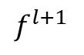
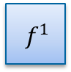
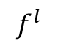
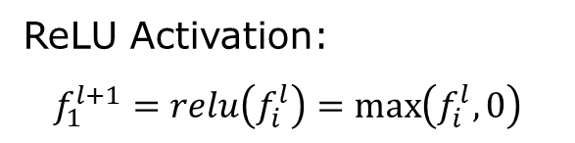
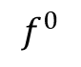
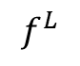

Normal Backprop
Forward pass
Input
image
$$f^{1}$$
...
$$f^{L−1}$$
1 | 0
3 | 2
Feature
map
$$f^{0}$$
$$f^{L}$$
1 | -1 | 5
2 | -5 | -7
-3 | 2 | 4
1 | 0 | 5
2 | 0 | 0
0 | 2 | 4
$$f^{l}$$
$$f^{l+1}$$
ReLU Activation:
$$f_{1}^{l+1}=relu\left(f_{i}^{l}\right)=\max\left(f_{i}^{l},0\right)$$
Computer Vision

Slide 57








Normal Backprop
Backward pass
Reconstructed
Image $R^{0}$
$$R^{1}$$
...
$$R^{L−1}$$
0 | 0
0 | 2
Feature
map
$$R^{L}$$
-2 | 0 | -1
6 | 0 | 0
0 | -1 | 3
-2 | 3 | -1
6 | -3 | 1
2 | -1 | 3
$$∂^{l}$$
$$∂^{l+1}$$
Normal Backprop: $$R_{i}^{l}=\left(f_{i}^{l}>0\right)∙R_{i}^{l+1}, where{ R}_{i}^{l+1}=\frac{∂f^{out}}{∂f_{i}^{l+1}}$$
Computer Vision

Slide 58



Guided backprop
Reconstructed
Image $R^{0}$
$$R^{1}$$
...
$$R^{L−1}$$
0 | 0
0 | 2
Feature
map
$$R^{L}$$
0 | 0 | 0
6 | 0 | 0
0 | 0 | 3
0 | 3 | 0
6 | 0 | 1
2 | 0 | 3
-2 | 3 | -1
6 | -3 | 1
2 | -1 | 3
$$∂^{l}$$
$$∂^{l+1}$$
Guided Backprop: $$R_{i}^{l}=\left(f_{i}^{l}>0\right)∙\left(R_{i}^{l+1}>0\right) , where{ R}_{i}^{l+1}=\frac{∂f^{out}}{∂f_{i}^{l+1}}$$
Computer Vision

Slide 59


Guided backprop
Backprop
Guided backprop
All negative and positive influences from the activation
Only positive influences from the activation
Computer Vision

Slide 60
Trained on ImageNet.
Each row corresponds to one filter.
The visualization using “guided backpropagation” is based on the top 10 image patches activating this filter taken from the ImageNet dataset.
[Striving for Simplicity: The all convolutional net, Springenberg, Dosovitskiy, et al., 2015]
Computer Vision
Notes:
Visualization of patterns learned by the layer conv6
(top) and layer conv9 (bottom) of the network trained on ImageNet.

Slide 61


Trained on ImageNet.
Each row corresponds to one filter.
The visualization using “guided backpropagation” is based on the top 10 image patches activating this filter taken from the ImageNet dataset.
[Striving for Simplicity: The all convolutional net, Springenberg, Dosovitskiy, et al., 2015]
Computer Vision
Notes:
Visualization of patterns learned by the layer conv6
(top) and layer conv9 (bottom) of the network trained on ImageNet.

Slide 62

deConvNet approach
Reconstructed
Image $R^{0}$
$$R^{1}$$
...
$$R^{L−1}$$
0 | 1
1 | 2
Feature
map
$$R^{L}$$
0 | 3 | 0
6 | 0 | 1
2 | 0 | 3
-2 | 3 | -1
6 | -3 | 1
2 | -1 | 3
Deconvnet Backprop: $$R_{i}^{l}=\left(R_{i}^{l+1}>0\right)∙{ R}_{i}^{l+1}, where{ R}_{i}^{l+1}=\frac{∂f^{out}}{∂f_{i}^{l+1}}$$
[Visualizing and Understanding Convolutional Networks, Zeiler and Fergus 2013]
Computer Vision

Slide 63

deConvNet approach
[Visualizing and Understanding Convolutional Networks, Zeiler and Fergus 2013]
Computer Vision

Slide 64

deConvNet approach
[Visualizing and Understanding Convolutional Networks, Zeiler and Fergus 2013]
Computer Vision

Slide 65

Computer Vision

Slide 66
Conclusion 6
Using gradients and Backpropagation, we can visualize what part of input activate a neuron (filter)
The result confirm the visualization using backtracking
Computer Vision

Slide 67
DeepVis toolbox
Computer Vision

Slide 68

DeepVis toolbox
Real-time Camera feed
http://yosinski.com/deepvis
www.youtube.com/watch?v=AgkfIQ4IGaM
[Yosinski et al, “Understanding Neural Networks Through Deep Visualization”, ICML DL Workshop 2014]
Computer Vision

Slide 69

Visualizing Activations
DeepVis toolbox
Real-time Camera feed
http://yosinski.com/deepvis
2 methods presented
DeConv-based
Optimization-based
www.youtube.com/watch?v=AgkfIQ4IGaM
[Yosinski et al, “Understanding Neural Networks Through Deep Visualization”, ICML DL Workshop 2014]
Computer Vision

Slide 70
DeConv approach
[Visualizing and Understanding Convolutional Networks, Zeiler and Fergus 2013]
[Deep Inside Convolutional Networks: Visualising Image Classification Models and Saliency Maps, Simonyan et al., 2014]
[Striving for Simplicity: The all convolutional net, Springenberg, Dosovitskiy, et al., 2015]
Computer Vision

Slide 71

Break, Question?
Computer Vision

